Slide 1

INT234 PREDICTIVE ANALYTICS
Lecture #0
The kick start session

Slide 2
Course Overview
Course Code : INT234
LTP – 2 0 2[Two Lectures and Two Practical's/week]
Credits – 3

Slide 3
Course Outcomes
CO1 :: explain the basics of data preprocessing and its implementation by using R programming Language.
CO2 :: define the basics of classification by using Supervised Learning Algorithms.
CO3 :: Make use of different Supervised learning techniques to predict numeric values.
CO4 :: demonstrate the predictive models by using Neural networks and Support vector machines.
CO5 :: classify the data by implementing unsupervised learning algorithms.
CO6 :: illustrate the techniques to evaluate the model performance and various methods to improve it.

Slide 4
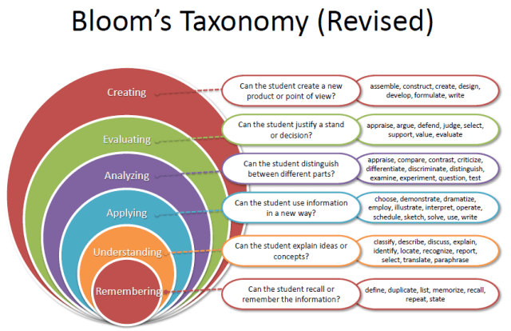
Revised Bloom’s Taxonomy

Slide 5
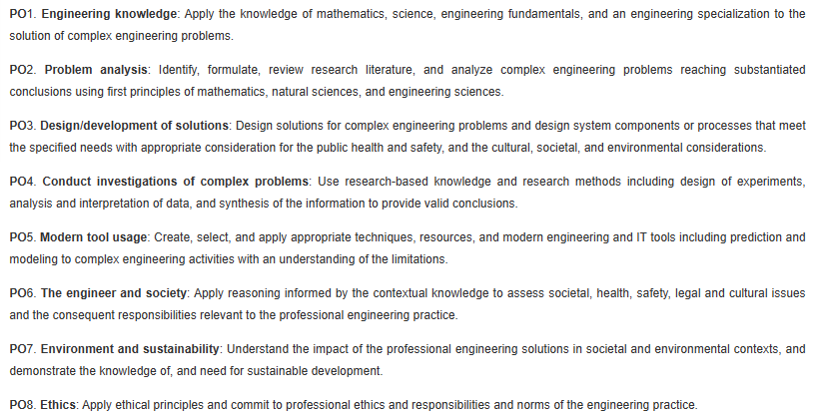
Program Outcomes (POs)

Slide 6
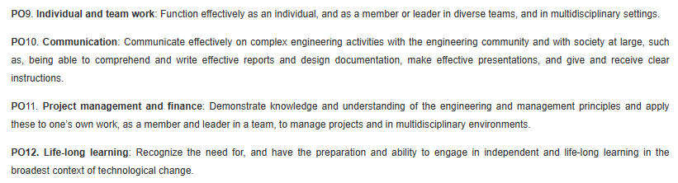
Program Outcomes (POs)

Slide 7

What is Predictive Analytics?

Slide 8
Predictive Analytics
Predictive Analytics is the domain that deals with the various aspects of statistical techniques including predictive modeling, data mining, machine learning, analyzing current and historical data to make the predictions for the future.

Slide 9
..ctd
Predictive analytics is a branch of data science and statistics understanding the patterns from the historical data and applying these patterns to current data to understand the future possible outcomes. Today organizations are sitting on tons of data. For organizations, it makes perfect sense to analyze this existing historical data for trends, build a model based on these patterns and apply the model to the current data to predict the future events. Tools required for predictive analytics can include data mining techniques, artificial intelligence, statistics, machine learning.

Slide 10
PRACTICAL APPLICATIONS
Predictive analytics is considered a star course and is highly sought after by both students and employers for several reasons:
Growing Demand: Predictive analytics has become an integral part of decision-making processes in various industries. Organizations are increasingly relying on data-driven insights to gain a competitive edge, optimize operations, and enhance customer experiences. As a result, there is a growing demand for professionals skilled in predictive analytics.
Valuable Skillset: Predictive analytics involves using historical data and statistical algorithms to make predictions about future outcomes. Individuals with expertise in this field can identify patterns, trends, and potential outcomes from data, enabling businesses to make informed decisions and devise effective strategies.

Slide 11
Course Content
Unit I
DATA PREPROCESSING : Managing data with R, Exploring and understanding data, Exploring the structure of data, Exploring numeric variables, Exploring categorical variables, Exploring relationships between variables
Unit II
SUPERVISED LEARNING: CLASSIFICATION : Lazy learning: Nearest neighbors, Probabilistic Learning: Using Naive Bayes, Divide and Conquer: Decision Trees and Rules
Unit III
SURPERVISED LEARNING : NUMERIC PREDICTION : Forecasting Numeric Data, Simple Linear Regression, Polynomial Regression, Ordinary least squares estimation, Correlations

Slide 12
Unit IV
SUPERVISED LEARNING:DUAL USE : Black Box Methods, Neural Networks, Support Vector Machines
Unit V
UNSUPERVISED LEARNING: CLUSTERING AND PATTERN DETECTION : K-Means Clustering, Kmeans clustering intuition, K-means random initialization trap, K-means selecting number of clusters, Dataset gathering, Hierarchical Clustering, Association Rules, Finding Patterns, Market Basket Analysis Using Association Rules
Unit VI
MODEL PERFORMANCE : Evaluation Model Performance, Improving Model Performance, Bagging, Boosting, Random forests

Slide 13
CA for this course
CA1 : BYOD PRACTICAL
CA2 : BYOD PRACTICAL
CA3 : Project
Best 2 out of 3 will be counted.

Slide 14
Project Detail (10 Marks Distribution)
Marks | 4 | 3 | 2 | 1
Likes (4) | 200 | 150 | 100 | 50
Share (3) | NA | 20 | 15 | 10
Comment (3) | NA | 20 | 15 | 10

Slide 15
Marks Breakup
Credits : 3
Marks Breakup:
* 2 Best CA out of 3 CA each of 30 marks
* No MTE
Activity | Marks
Attendance | 5
Continuous Assessment | 45
End-Term Practical (ETP) | 50
Total | 100

Slide 16
Why Star Course??
Predictive analytics is considered a star course and is highly sought after by both students and employers for several reasons:
Growing Demand: Predictive analytics has become an integral part of decision-making processes in various industries. Organizations are increasingly relying on data-driven insights to gain a competitive edge, optimize operations, and enhance customer experiences. As a result, there is a growing demand for professionals skilled in predictive analytics.
Valuable Skillset: Predictive analytics involves using historical data and statistical algorithms to make predictions about future outcomes. Individuals with expertise in this field can identify patterns, trends, and potential outcomes from data, enabling businesses to make informed decisions and devise effective strategies.

Slide 17
Why Star Course??
Real-World Applications: Predictive analytics finds applications across diverse sectors, including finance, marketing, healthcare, retail, manufacturing, and more. Students who learn predictive analytics gain the ability to tackle real-world business challenges, making them valuable assets to employers.
Return on Investment: Employers see predictive analytics as an investment because it can lead to cost savings and revenue growth. By leveraging data to make better predictions, businesses can optimize inventory, reduce waste, improve marketing campaigns, and enhance customer retention, resulting in significant returns on investment.
Forward-Looking Focus: Unlike descriptive analytics, which focuses on explaining past events, predictive analytics concentrates on future possibilities. This forward-looking approach allows companies to anticipate market trends, identify potential risks, and be better prepared for upcoming challenges.

Slide 18
Competitive Advantage: Businesses that effectively leverage predictive analytics can gain a competitive advantage over their peers. Having employees skilled in this area enables companies to stay ahead of the curve, respond quickly to changes in the market, and innovate based on data-driven insights.
High Placement Opportunities: Given the increasing demand for professionals with predictive analytics expertise and the shortage of qualified candidates, students who have completed courses or certifications in this field have a higher likelihood of securing job placements and competitive salary packages.
Advancements in Technology: As technology evolves, the scope and capabilities of predictive analytics continue to expand. The integration of artificial intelligence and machine learning further enhances the predictive modeling process, making it even more valuable in addressing complex business challenges.
In conclusion, predictive analytics is a star course due to its relevance in today's data-driven world. It equips students with valuable skills, offers numerous real-world applications, and provides a competitive advantage to businesses. As a result, professionals trained in predictive analytics are in high demand, leading to excellent placement opportunities in various industries.

Slide 19
Reference Books:
APPLIED PREDICTIVE ANALYTICS: PRINCIPLES AND TECHNIQUES FOR THE PROFESSIONAL DATA ANALYST by DEAN ABBOTT, WILEY, 4th Edition, (2012)
PREDICTIVE ANALYTICS: THE POWER TO PREDICT by ERIC SIEGEL, WILEY
EFFICIENT R PROGRAMMING: A PRACTICAL GUIDE TO SMARTER PROGRAMMING by COLIN GILLESPIE AND ROBIN LOVELACE, SHROFF/O'REILLY
PYTHON AND R FOR THE MODERN DATA SCIENTIST: THE BEST OF BOTH WORLDS by RICK J. SCAVETTA AND BOYAN ANGELOV, SHROFF/O'REILLY
INTRODUCTION TO MACHINE LEARNING WITH R: RIGOROUS MATHEMATICAL ANALYSIS by SCOTT BURGER, SHROFF/O'REILLY
R IN A NUTSHELL 2E by JOSEPH ADLER, O'REILLY

Slide 20
MOOCs or Industry certification
Course Code | Course Title | Name of Mapped MOOC/Certification/Hackathon | Is Proctored | CA Benefit Count | MTT Benefit | ETE Benefit
INT234 | PREDICTIVE ANALYTICS | Supervised Machine Learning: Regression and Classification https://www.coursera.org/learn/machine-learning?utm_source=impact&utm_medium=partners&utm_campaign=27795&utm_content=b2c&campaignid=1776545273&adgroupid=69298819109&device=c&keyword=machine%20learning%20for%20beginners&matchtype=b&network=g&devicemodel=&adpostion=&creativeid=346568280203&hide_mobile_promo&gclid=CjwKCAjw0dKXBhBPEiwA2bmObRe4QEF_jG-INavuZLfQJ87EZ762Djf2pA8bee4lHTRwleWmYRUqehoCCg8QAvD_BwE&irclickid=W6G3rOwnUxyKW0xyvIwhJ2LDUkC2dnzl%3ATJhwE0&irgwc=1 | NO | One CA exempted | NO | NO

Slide 21
OER
Unit mapped | Broad topic | Sub Topic | Source Type | Source Title | *%age mapping (approx) | Source URL
Unit 1 | DATA PREPROCESSING | Managing data with R, Exploring and understanding data, Exploring the structure of data, exploring numeric variables, Exploring categorical variables, Exploring relationships between variables | Reading (Website) | Finding Relationships in Data with R | 100 | https://www.pluralsight.com/resources/blog/guides/finding-relationships-data-with-r

Slide 22
Unit 2 | SUPERVISED LEARNING: CLASSIFICATION | Lazy learning: Nearest neighbors, Probabilistic Learning: Using Naive Bayes, Divide and Conquer: Decision Trees and Rules. | Reading (Website) | Classification Algorithm in Machine Learning | 100 | https://www.analytixlabs.co.in/blog/classification-in-machine-learning/
Unit 3 | SURPERVISED LEARNING : NUMERIC PREDICTION | Forecasting Numeric Data, Simple Linear Regression, Polynomial Regression, Ordinary least squares estimation, Correlations | Reading (Website) | Linear regression from scratch | 100 | https://developer.ibm.com/articles/linear-regression-from-scratch/

Slide 23
Unit 4 | SUPERVISED LEARNING:DUAL USE | Black Box Methods : Neural Networks, Support Vector Machines | Reading (Website) | Support Vector Machines vs Neural Networks | 100 | https://www.geeksforgeeks.org/support-vector-machines-vs-neural-networks/
Unit 5 | UNSUPERVISED LEARNING: CLUSTERING AND PATTERN DETECTION | K-Means Clustering, Kmeans clustering intuition, K-means random initialization trap, K-means selecting number of clusters, Dataset gathering, Hierarchical Clustering, Association Rules, Finding Patterns, Market Basket Analysis Using Association Rules | Reading (Website) | Introduction to K-Means Clustering Algorithm | 100 | https://www.analyticsvidhya.com/blog/2019/08/comprehensive-guide-k-means-clustering/

Slide 24
Unit 6 | MODEL PERFORMANCE | Evaluation Model Performance, Improving Model Performance, Bagging, Boosting, Random forests | Reading (Website) | Bagging, Boosting, and Stacking in Machine Learning | 100 | https://www.baeldung.com/cs/bagging-boosting-stacking-ml-ensemble-models

Slide 25
What are Cohorts
A group of students of a common programme who intend to attain similar characteristics by means of learning similar skills in order to target a particular career opportunity.

Slide 26
Purpose of Cohorts
Student shall be able to have a goal oriented approach for his/her career
Student identifies the goal in the very first year
Student shall be able to follow the stage wise career progression.
Early identification of skill set required for selected goal.

Slide 27




Outline Cohort’s:
Cohort 1: Software Development (Product Based)
Cohort 2: Data Science
Cohort 3: Cyber Security
Cohort 4: Full Stack Web Development
Cohort 5: Machine Learning
Cohort 6: Cloud Computing
Cohort 7: Software Methodologies And Testing
Cohort 8: Software Development (Service Based)
Cohort 9: Entrepreneurship
Cohort 10: Mobile Application Development
Cohort 11: Government jobs/Higher studies

Slide 28
Cohort 2: Data Science
Companies
Skills Required
Skills Sources – Internal
Skills Sources – External

Slide 29













Cohort 2: Data Science
Companies
10-20 LPA
Accenture
Quick Heal
Informatica
IBM
AMDOCs
Norton
Up to 10 LPA
TCS
Deloitte
Quantiphi
Capgemini
20-30 LPA
Amazon
Flipkart
Deloitte
HP

Slide 30
Cohort 2: Data Science
Skills Required
S1 - DATA MANAGEMENT
S2 - DATA VISUALIZATION
S3 - DATA EXPLORATION AND ANALYSIS
S4 - R LANGUAGE
S5 - PREDICTIVE ANALYTICS
S6– DATA CLASSIFICATION
S7 - DATA ANALYTICS
S8 – PYTHON LANGUAGE
S9 – RECOMMENDER SYSTEMS
S10 - DATA PREDICTION

Slide 31
Cohort 2: Data Science
Skills Sources – Internal
MAIN COURSE
INT306: DATABASE MANAGEMENT SYSTEM[S1]
INT108: PYTHON PROGRAMMING[S8]
ELECTIVE COURSE
INT217: INTRODUCTION TO DATA MANAGEMENT [S1]
INT233: DATA VISUALIZATION[S2,S3]
INT232: R PROGRAMMING [S4]
INT234:PREDICTIVE ANALYTICS [S7,S10,S5]
INT254: FUNDAMENTALS OF MACHINE LEARNING[S6]

Slide 32
Cohort 2: Data Science
Skills Sources – External
Source | Description | Suggested Source
Industry Certification | Data Visualization[S2] Data Exploration and Analysis[S3] | Tableau Tableau
MOOCs | Data Visualization in Excel[S1] Create Charts and Dashboards Using Microsoft Excel [S1] Excel Basics for Data Analysis"[S1] Data Visualization with Tableau Specialization[S2] Tableau Certified Data Analyst"[S2] R Programming[S4] Supervised Machine Learning: Regression and Classification [S5,S8] Machine Learning Specialization"[S5,S10] Recommender Systems Specialization[S9] | 1. Coursera 2. Coursera 3. Coursera 4. Coursera 5. Coursera 6. Coursera 7. Coursera 8. Coursera 9. Coursera

Slide 33

Jump Board Initiatives
to
foster your
DREAM CAREER

Slide 34
Next Class: Installation of Software

